Slide 1



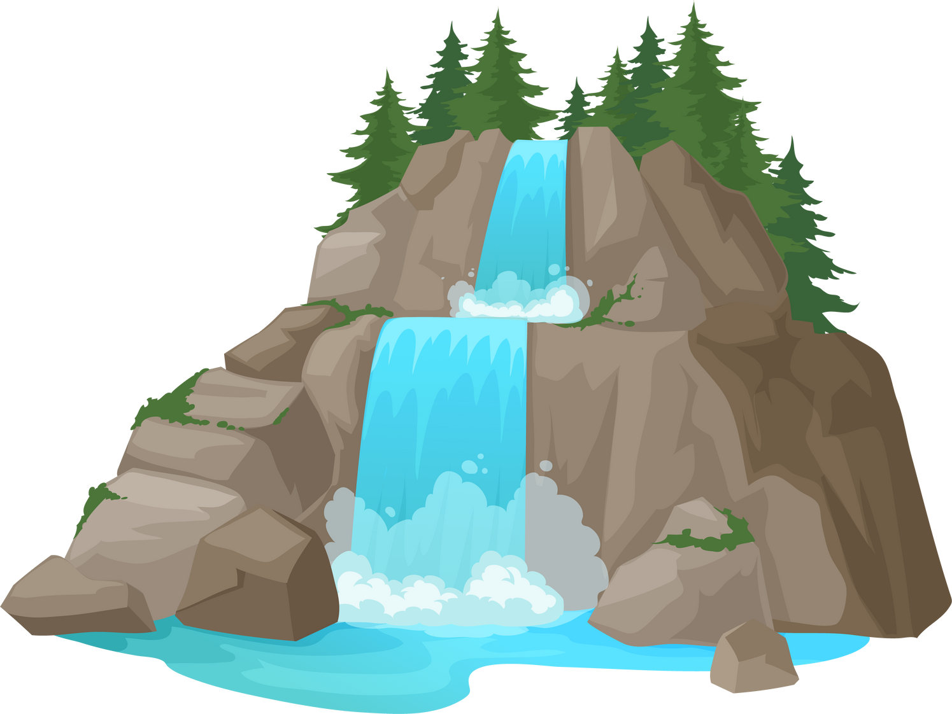

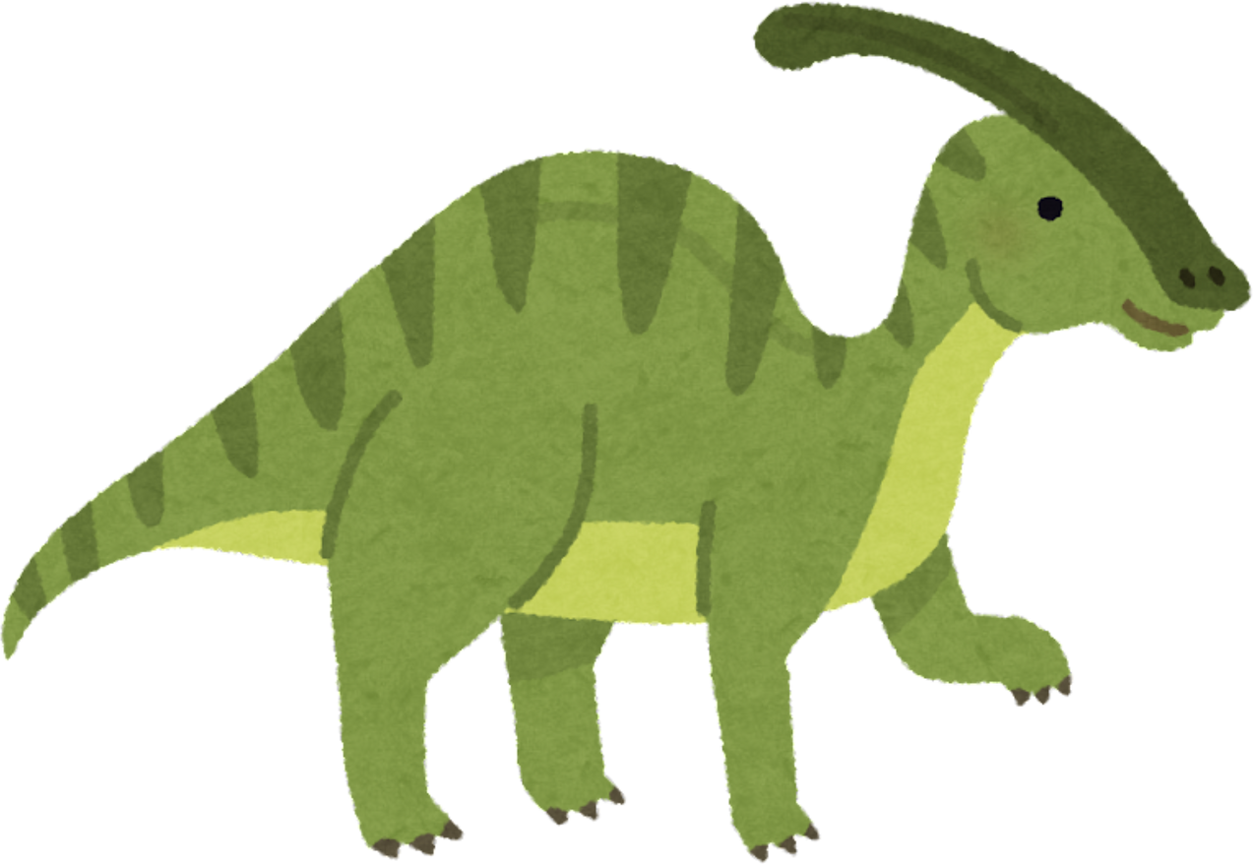
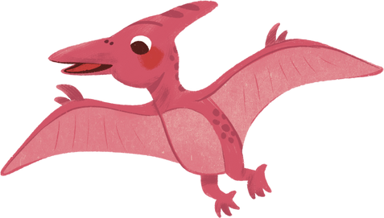


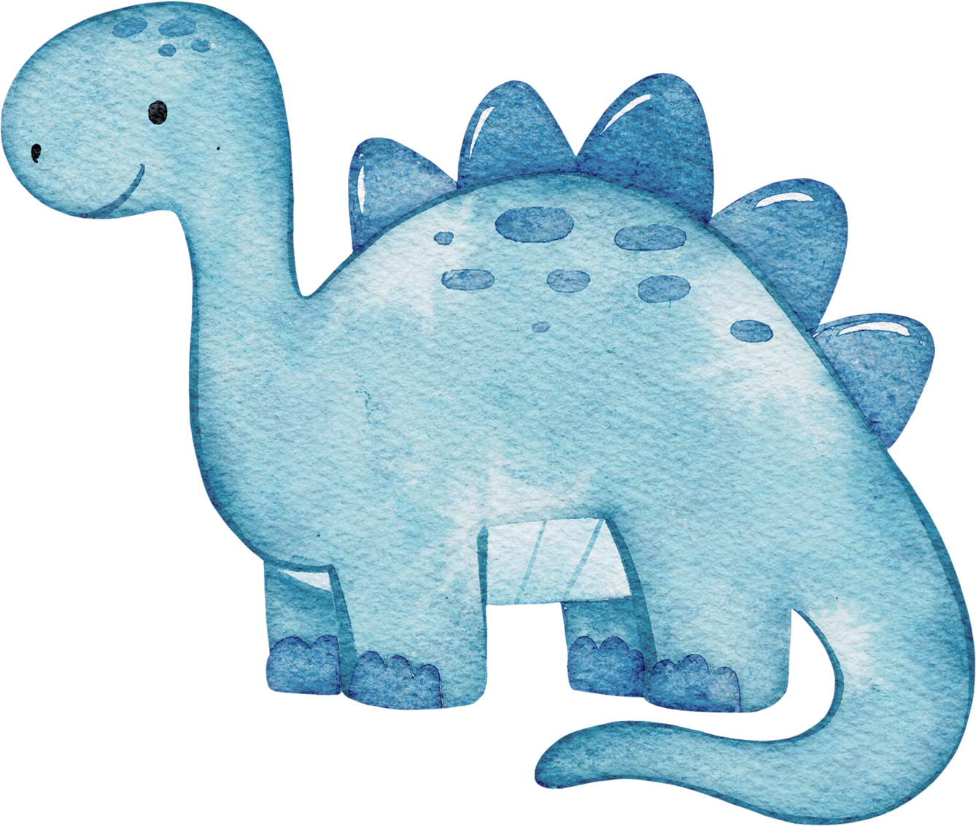
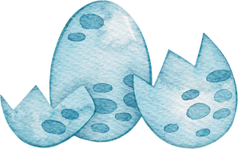

Gums Rock!
Keep Smiling
a short dental story....
Created by Hollie Nend & Frances Hodson

Slide 2
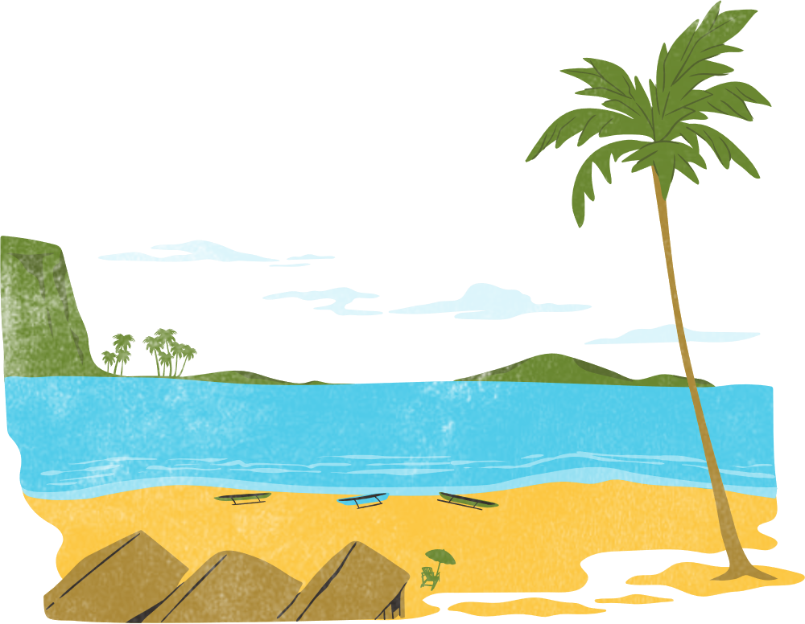


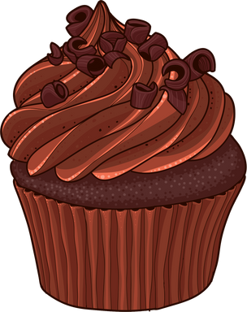
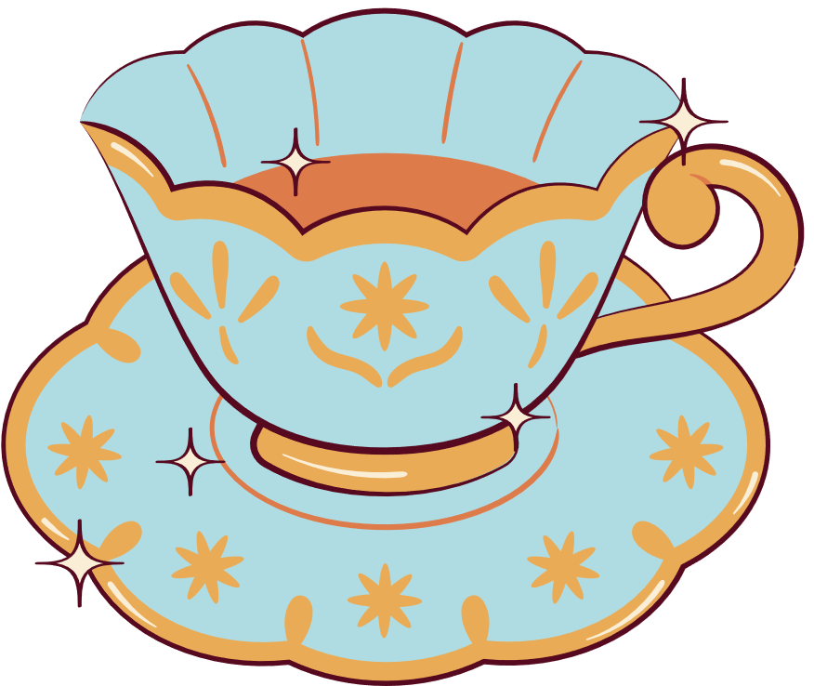
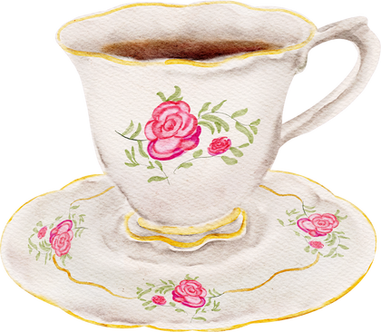
Spot and Stripe were sat on the beach eating their rock cakes and drinking their tea.
Spot looked up at Stripe and noticed he was looking sad and droopy.
Hey Stripe, why are you looking sad?
I’m okay...

Slide 3
Spot knew there was something wrong with Stripe as he had not eaten his rock cake or drank his favourite tea!
You have not touched your cake or tea!
You are not smiling.

Slide 4

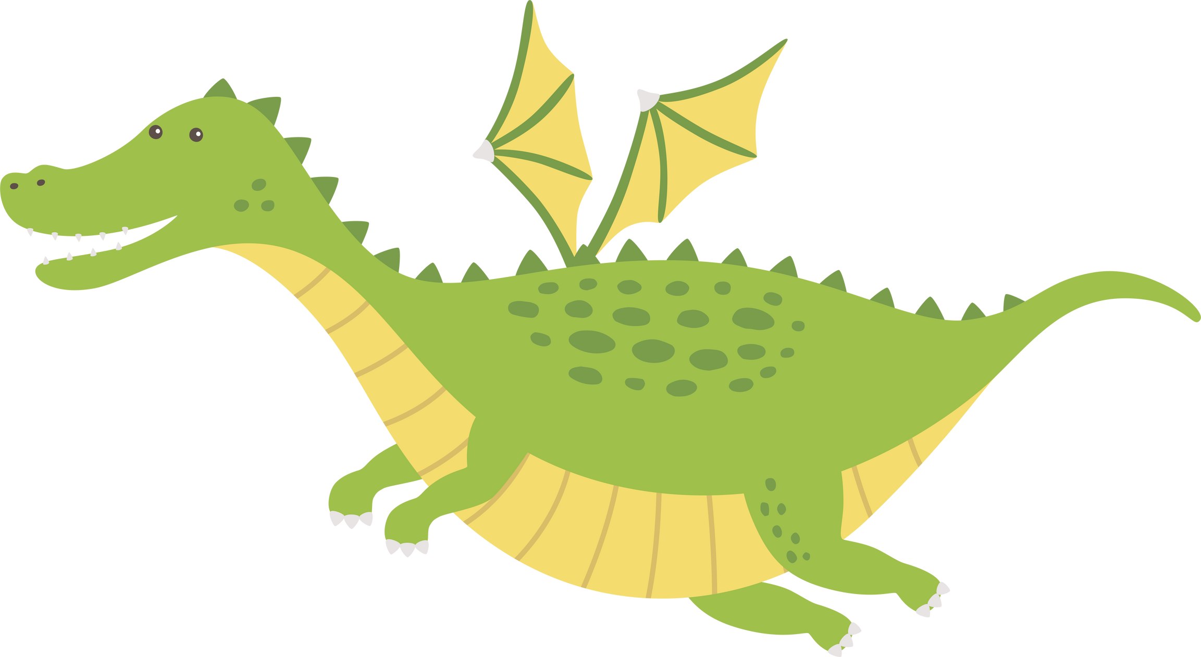


Stripe let out a big sigh,
“I just don’t feel like smiling today”...

Slide 5

“Why not?” Spot asked Stripe.
Stripe let out ANOTHER big sigh,
“I just feel embarrassed as my gums
are bright and bleed when I eat”.
RED

Slide 6
Spot was shocked! He felt sorry for Stripe.
“Have you seen a dentist recently?” asked Spot.
“No, I am scared they will tell me off… I have been brushing my teeth every day, I promise,” Stripe sniffled.

Slide 7

All of a sudden Spot had an idea...
he knew just the place to fix this.

Slide 8






“Don’t worry Stripe, come and see my friends
at Mammoth Smiles.”
“They are friendly and caring. They can help fix your teeth like they helped me too!”
said Spot with a big grin on his face.

Slide 9


Stripe was still a little confused and unsure what was going on inside his mouth and asked Spot to explain it to him.

Slide 10
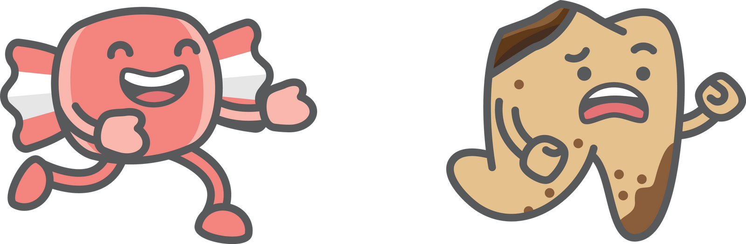
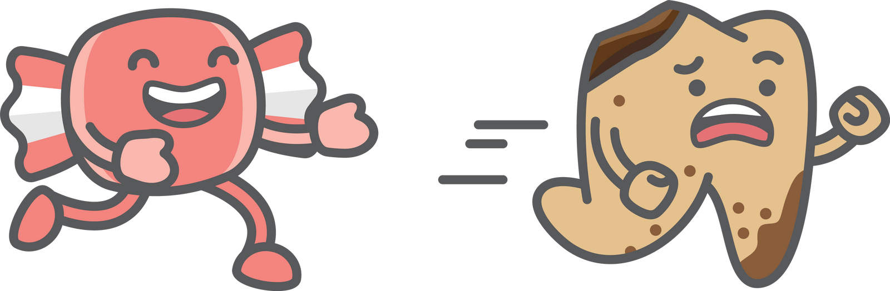
“Gum disease happens when sticky stuff called plaque builds up on your teeth and your gums get sore and puffy because your body is trying to fight it off.”
“When gums do go red and puff up they might even bleed. Sometimes they try to run away from your teeth,” explained Spot.

Slide 11


"I saw that my teeth looked poorly too, but I just thought that happened when you get older," said Spot.
“Well... what happened next?” asked Stripe

Slide 12

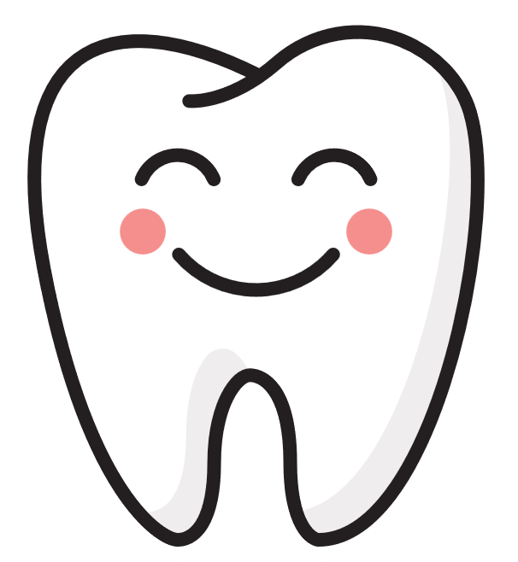
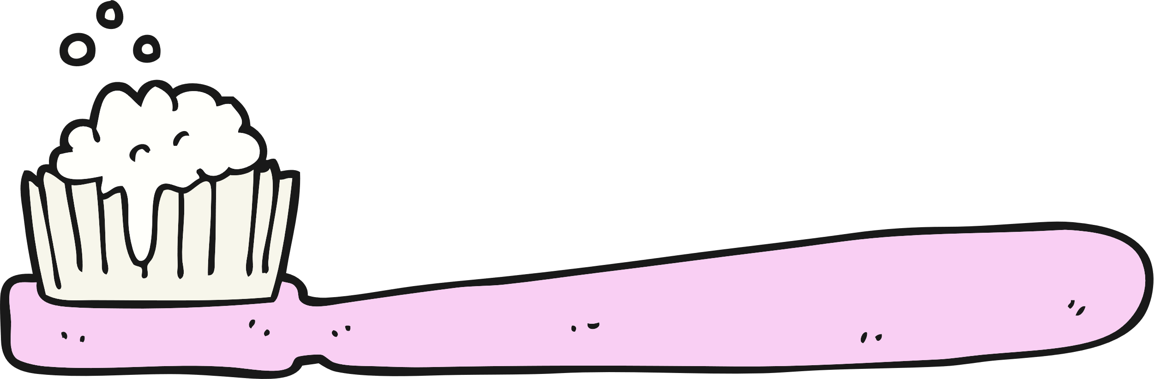
“Well, I found out it is called, Periodontitis,” said Spot. “It makes your gums sore and if we don’t stop it, it can hurt the bones that hold your teeth!’"
“Your teeth stand on bone, just like we stand on the ground,” said Spot.
If the bone gets weak, the teeth can get wobbly and you might”.....
L
0
e
s
t
t
e
u
e
y
r
h
o

Slide 13

“Oh no! I do not want to end up like Agnes!” Stripe said with a giggle.
“She’s only got a few teeth left and a smile full of gaps!”.... said Spot.

Slide 14
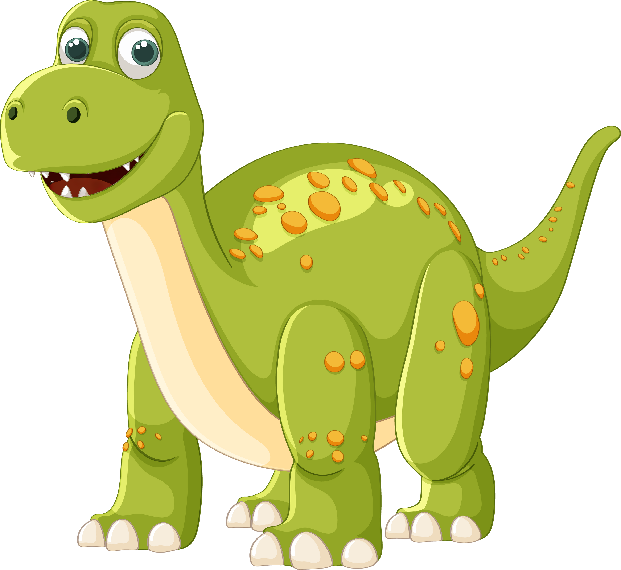


Slide 15

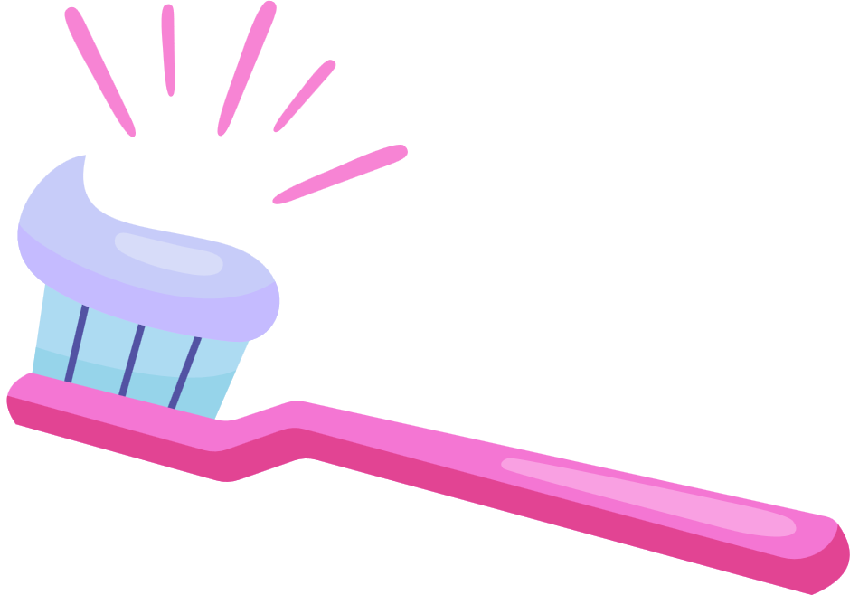


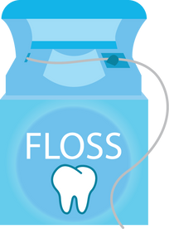


“Well, to make my teeth better again, my dentist taught me how to be a super toothbrush Ninja Warrior!” Said Spot.

Slide 16
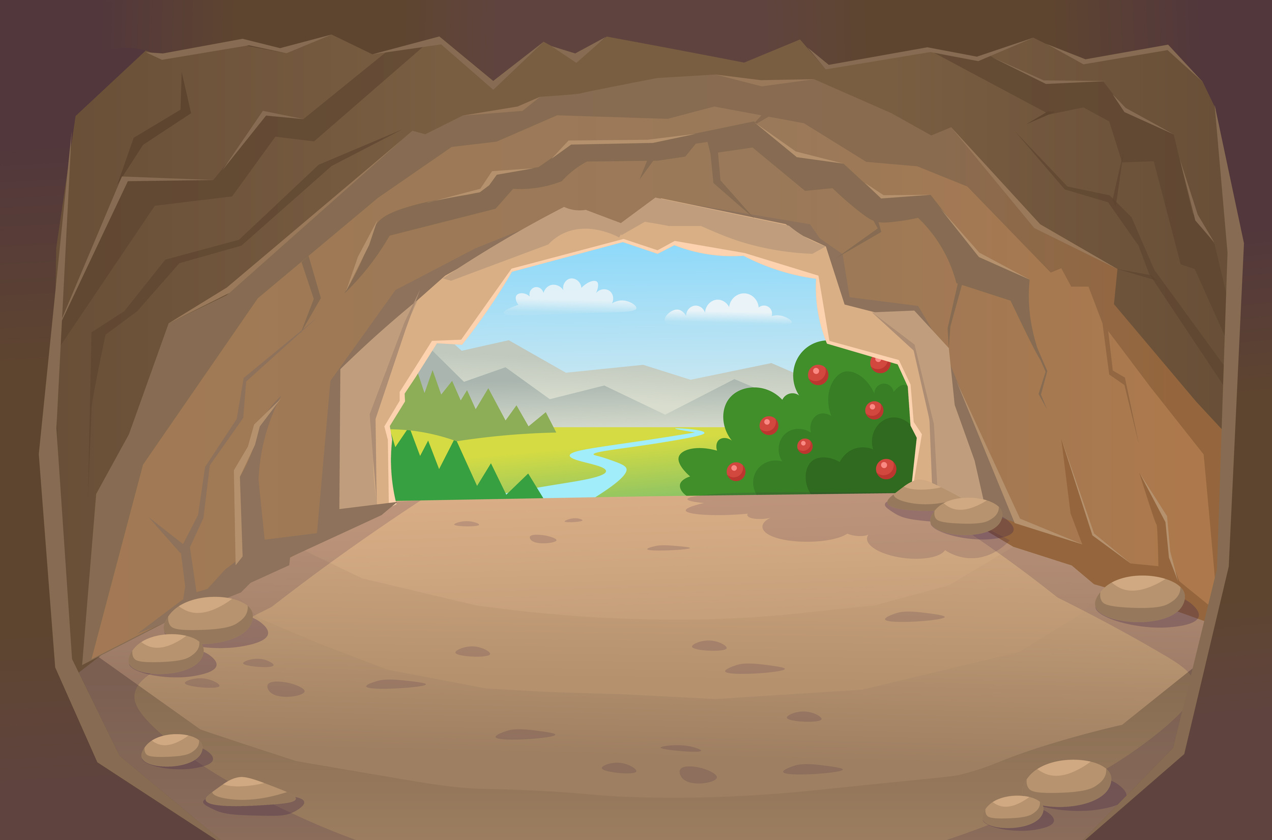




“I now brush my teeth every morning and night. It takes a little time, but - wow — it makes me feel so much better!”
BRUSH TEETH
REMEMBER TO BRUSH
BRUSH!!!!!
EAT ROCK CAKE
“I make sure that I take my time when I brush my teeth, so they get extra squeaky clean,” said Spot.

Slide 17
Stripe felt relieved.
He was happy he knew what was happening and how to make his teeth happy again.
He was even more excited to see the dentist!

Slide 18
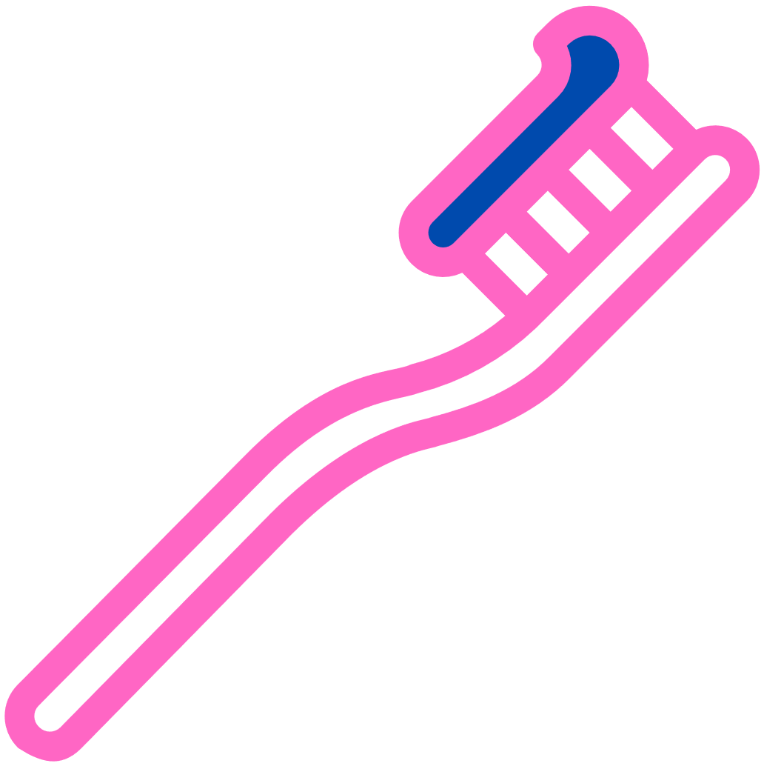



And the best bit about it all.....my mouth feels better and I can smile again!

Slide 19



“I used to hide my smile too — just like you but then the dentist helped me and now I love to smile!”
““Gum disease can’t be fixed completely,” said Spot,
“but with brushing and regular visits to the dentist, my teeth stay strong and healthy!”

Slide 20
“Thank you for helping me Spot.
I will go and see the dentist because I want a mammoth
smile just like you,” Smiled Stripe

Slide 21
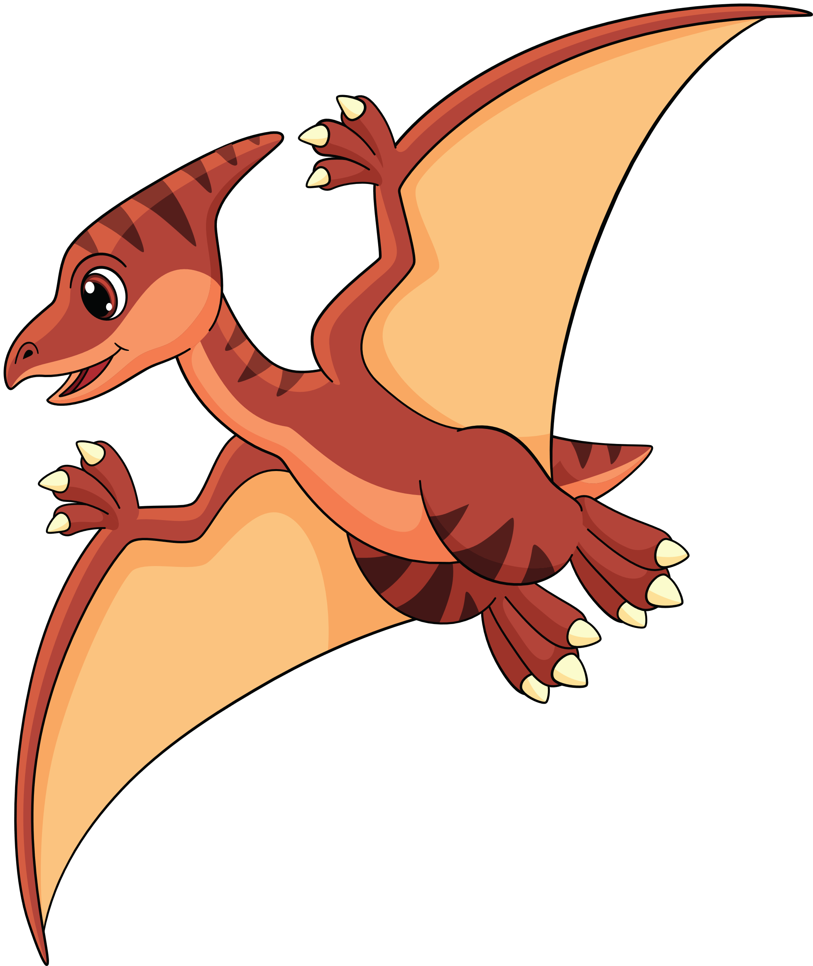

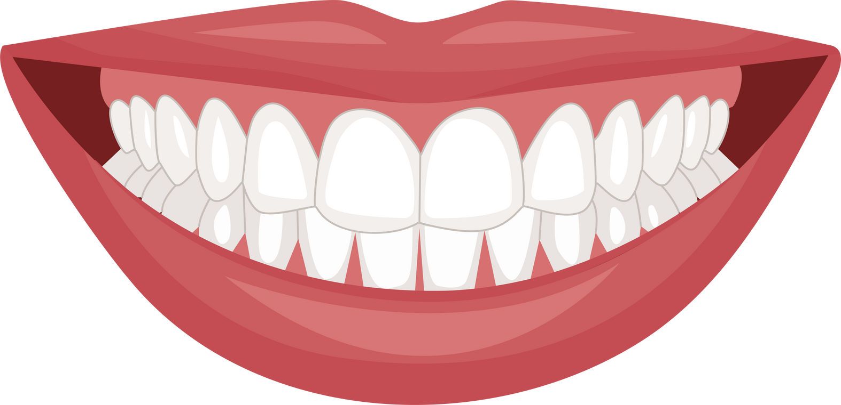
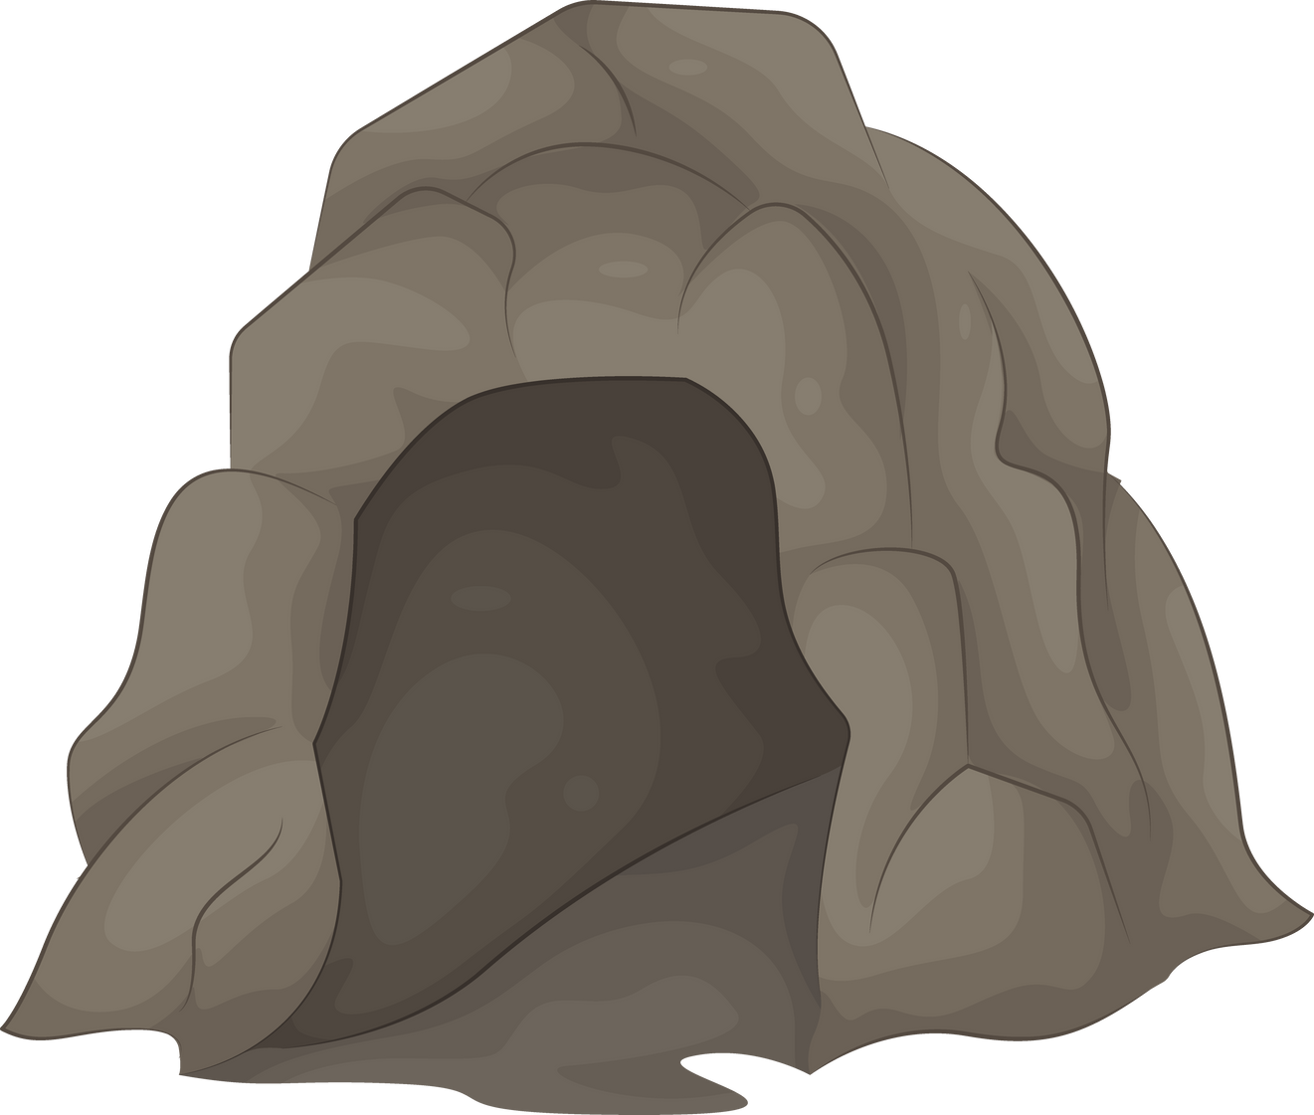
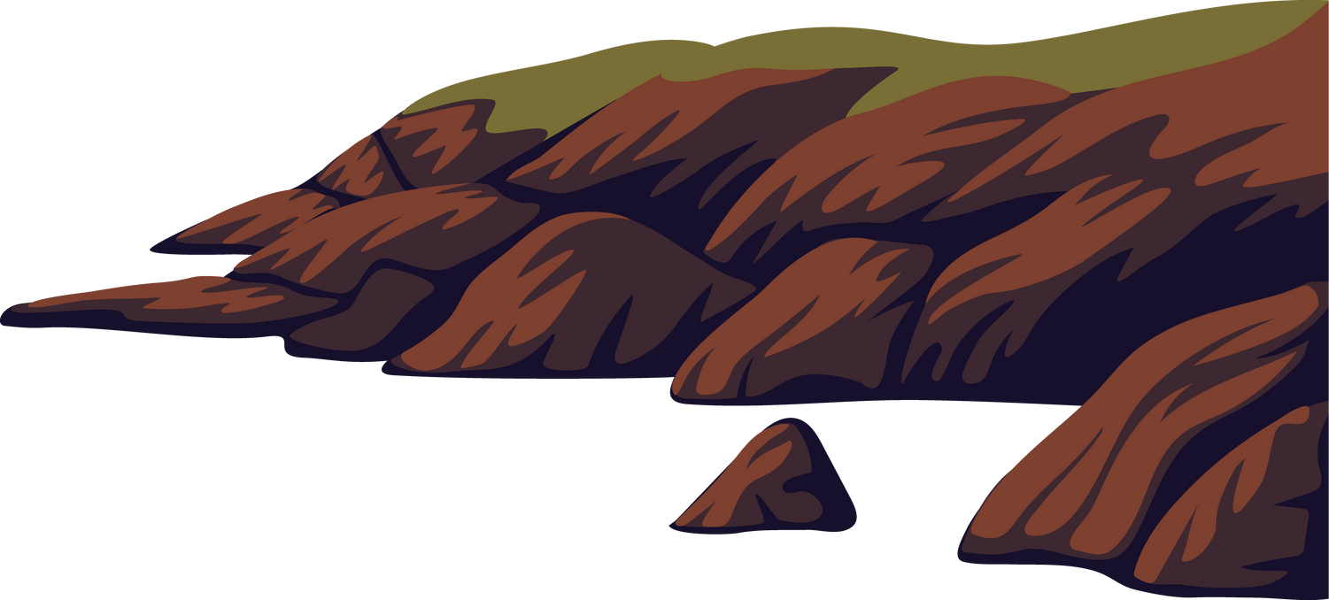
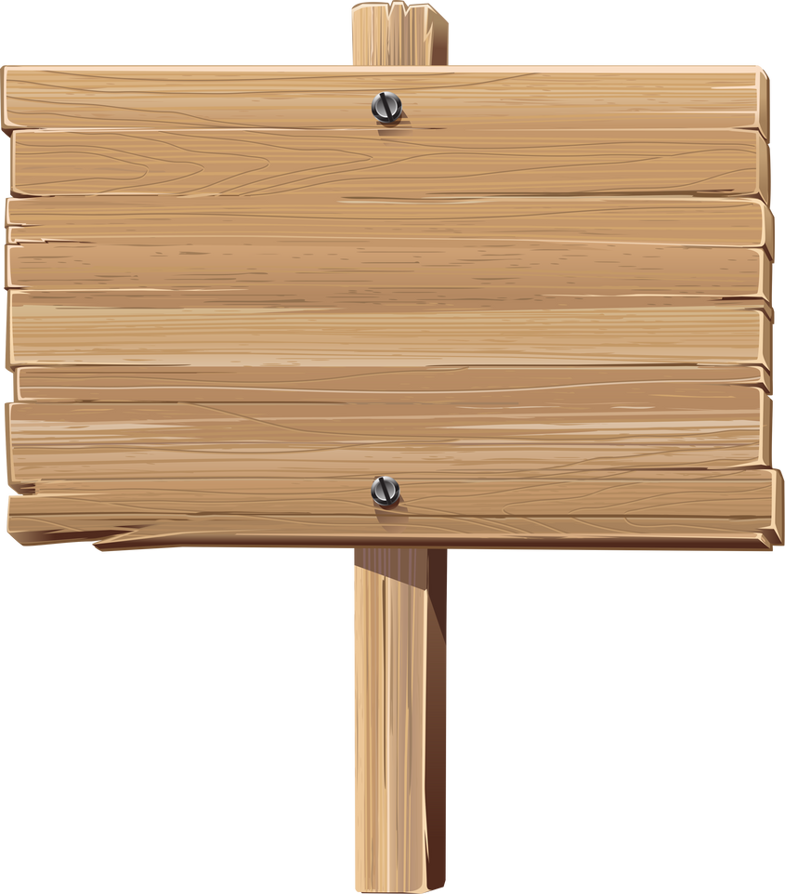

Gums Rock! Keep smiling.

